Slide 1

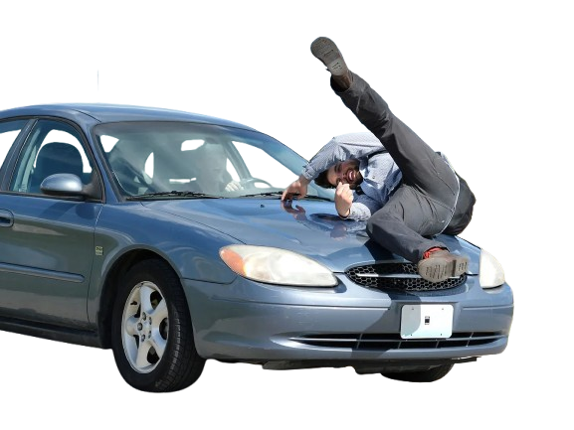
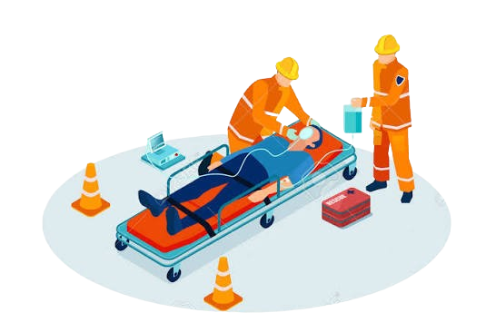
A Case Report Multiple Trauma
Attended by: Dr. Esmaeili
Presented by: Mahdi Poursalehi
Department of surgery

Slide 2
A Case Report
Multiple Trauma
A Case Report Multiple Trauma
A 74 year old man was sent to this center by EMS following a pedestrian - car collision.
Attended by: Dr. Esmaeili
Presented by: Mahdi Poursalehi
Department of surgery

Slide 3
7:30
A Case Report Multiple Trauma
A 74 year old man was sent to this center by EMS following a pedestrian - car collision.
Primary survey
A
C
E
17:30
B
19:30
D
23:00

Slide 4

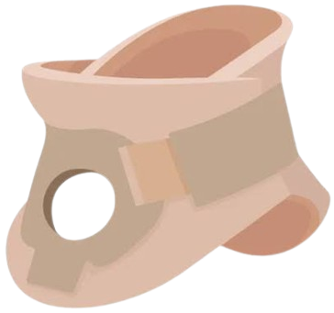
7:30
A Case Report Multiple Trauma
A 74 year old man was sent to this center by EMS following a pedestrian - car collision.
Primary survey
A
E
B
Normal Voice
Collar fix
17:30
D
C
19:30
23:00

Slide 5
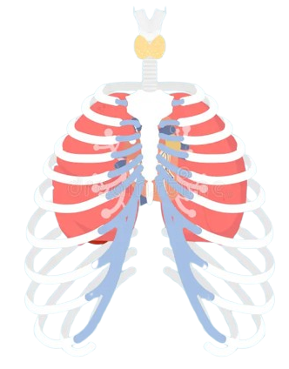
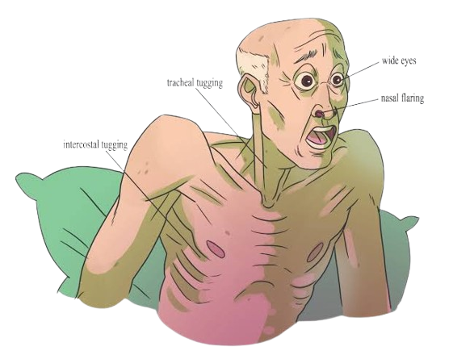

7:30
A Case Report Multiple Trauma
A 74 year old man was sent to this center by EMS following a pedestrian - car collision.
Primary survey
B
Symmetrical chest expansion
NO Respiratory distress
NO flail chest
RR= 18
SPO2= 93%
A
C
17:30
E
D
19:30
23:00

Slide 6


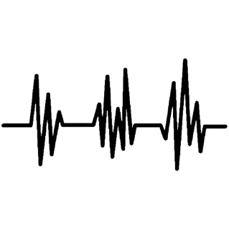
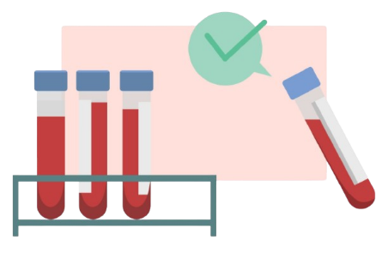
7:30
A Case Report Multiple Trauma
A 74 year old man was sent to this center by EMS following a pedestrian - car collision.
Primary survey
C
NO external bleeding
Negative FAST
BP= 100/70
PR= 66
NO Evidence of shock
Primary lab test was sent.
B
D
17:30
A
E
19:30
23:00

Slide 7
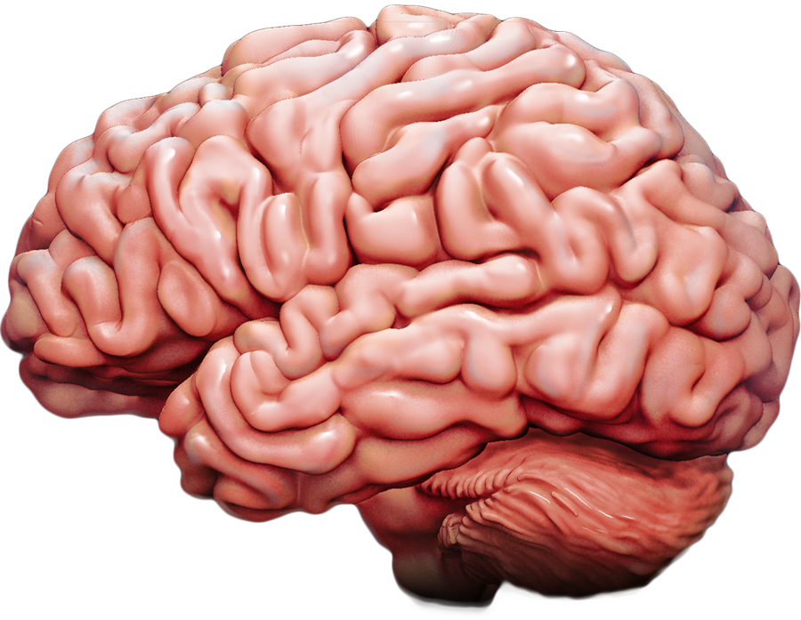
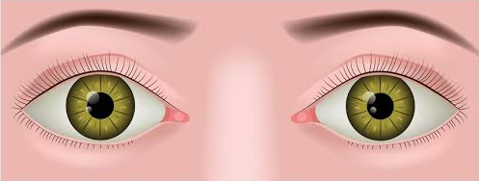
7:30
A Case Report Multiple Trauma
A 74 year old man was sent to this center by EMS following a pedestrian - car collision.
Primary survey
D
C
E
GCS= 15/15
medium-sized and reactive to light pupils
17:30
B
A
19:30
23:00

Slide 8

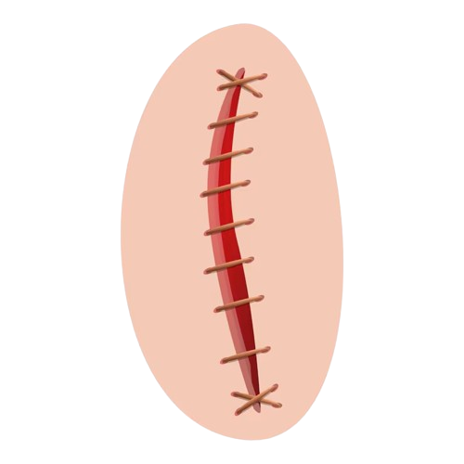

7:30
A Case Report Multiple Trauma
A 74 year old man was sent to this center by EMS following a pedestrian - car collision.
Primary survey
E
D
A
4-5 cm Laceration above the left eyebrow
7-8 cm laceration of the left leg under the left knee
Traumatic nose
  Nasal bone fx
  Left superior orbital wall fx
  Right posterior maxillary sinus wall fx
17:30
C
B
19:30
23:00

Slide 9
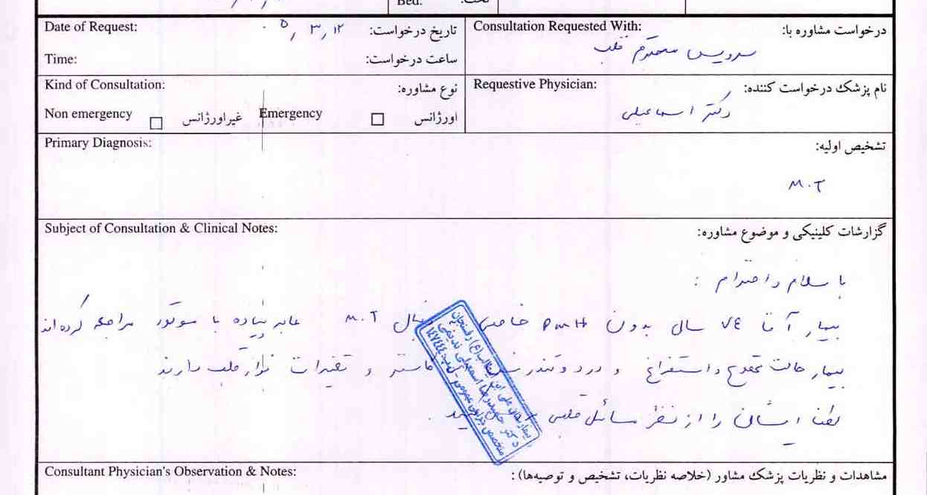
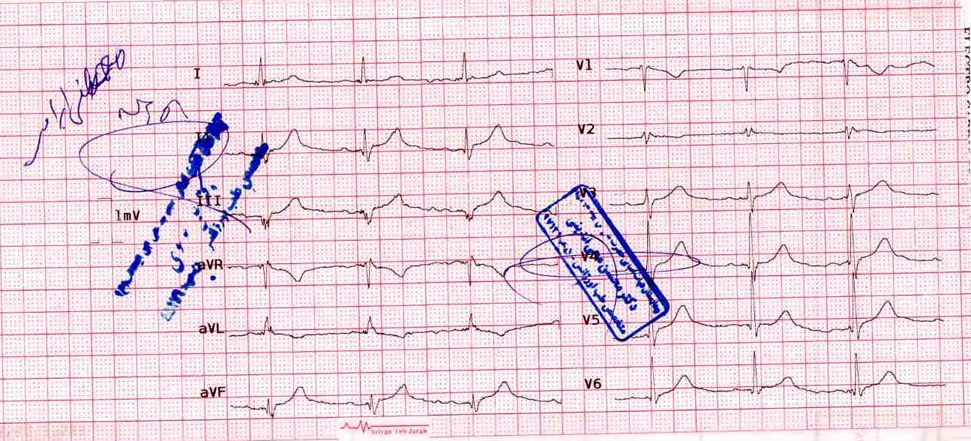
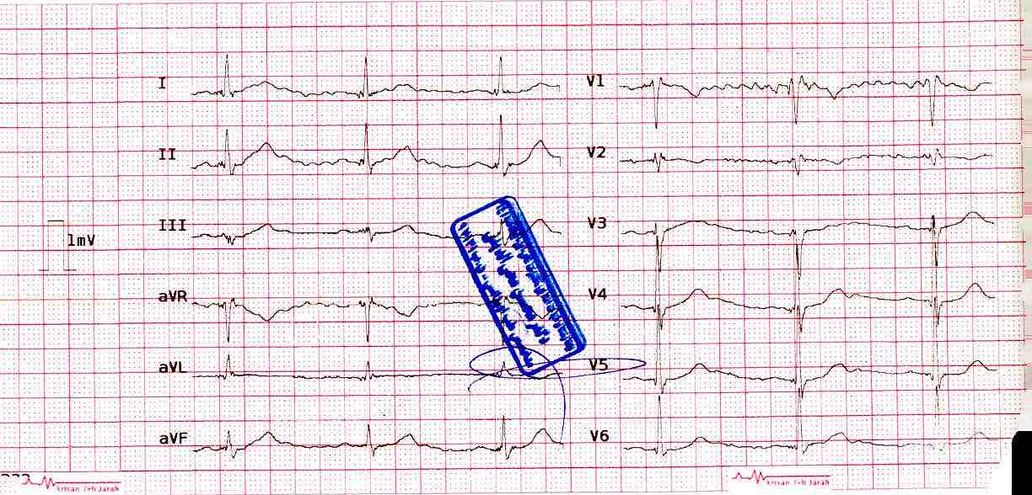
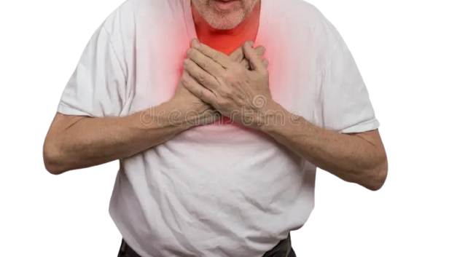
7:30
A Case Report Multiple Trauma
A 74 year old man was sent to this center by EMS following a pedestrian - car collision.
Primary survey
E
Retrosternal chest pain
Heart consultation
EKG
Negative Troponin
D
A
17:30
C
B
19:30
23:00

Slide 10
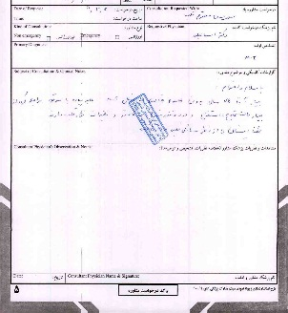
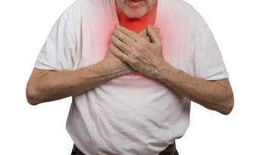
7:30
A Case Report Multiple Trauma
A 74 year old man was sent to this center by EMS following a pedestrian - car collision.
Primary survey
E
Retrosternal chest pain
Heart consultation
EKG
Negative Troponin
D
A
17:30
C
B
19:30
23:00

Slide 11
7:30
A Case Report Multiple Trauma
A 74 year old man was sent to this center by EMS following a pedestrian - car collision.
Primary survey
E
Retrosternal chest pain
Heart consultation
EKG
Negative Troponin
D
A
17:30
C
B
19:30
23:00

Slide 12
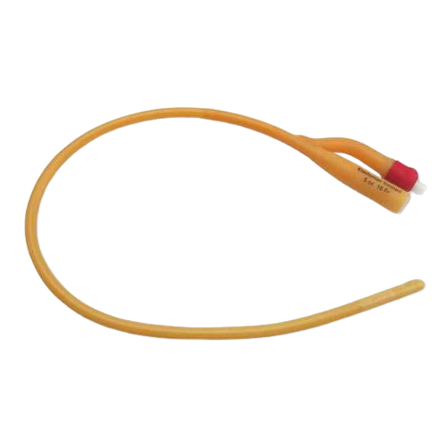
7:30
A Case Report Multiple Trauma
A 74 year old man was sent to this center by EMS following a pedestrian - car collision.
A
Secondary survey
B
F
C
D
17:30
E
Foley fix
19:30
{ 300 cc of clean and clear urine }
23:00

Slide 13
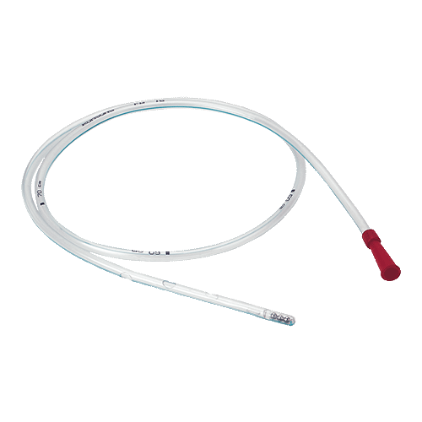
7:30
A Case Report Multiple Trauma
A 74 year old man was sent to this center by EMS following a pedestrian - car collision.
A
F
Secondary survey
G
B
C
Foley fix
D
17:30
E
NO NG
19:30
23:00

Slide 14
7:30
A Case Report Multiple Trauma
A 74 year old man was sent to this center by EMS following a pedestrian - car collision.
A
F
Secondary survey
B
A
C
Foley fix
M
D
G
H
17:30
E
P
19:30
L
NO NG
E
23:00

Slide 15
7:30
A Case Report Multiple Trauma
A 74 year old man was sent to this center by EMS following a pedestrian - car collision.
A
F
Secondary survey
B
A
C
Foley fix
M
D
G
H
17:30
E
P
Negative
Negative
The night before admission
Lumbar spine surgery 2 years ago
Pedestrian – car collision
19:30
L
NO NG
E
23:00

Slide 16

7:30
A Case Report Multiple Trauma
A 74 year old man was sent to this center by EMS following a pedestrian - car collision.
A
F
Secondary survey
B
A
Negative
C
Foley fix
M
D
G
H
17:30
E
P
Negative
The night before admission
Lumbar spine surgery 2 years ago
Pedestrian – car collision
19:30
L
NO NG
E
23:00

Slide 17

7:30
A Case Report Multiple Trauma
A 74 year old man was sent to this center by EMS following a pedestrian - car collision.
A
F
Secondary survey
B
A
Negative
C
Foley fix
M
D
Negative
G
H
17:30
E
P
The night before admission
Lumbar spine surgery 2 years ago
Pedestrian – car collision
19:30
L
NO NG
E
23:00

Slide 18

7:30
A Case Report Multiple Trauma
A 74 year old man was sent to this center by EMS following a pedestrian - car collision.
A
F
Secondary survey
B
A
Negative
C
Foley fix
M
D
Negative
G
H
17:30
E
P
The night before admission
Lumbar spine surgery 2 years ago
Pedestrian – car collision
19:30
L
NO NG
E
23:00

Slide 19

7:30
A Case Report Multiple Trauma
A 74 year old man was sent to this center by EMS following a pedestrian - car collision.
A
F
Secondary survey
B
A
Negative
C
Foley fix
M
D
Negative
G
H
17:30
E
P
Pedestrian – car collision
Lumbar spine surgery 2 years ago
19:30
L
NO NG
The night before admission
E
23:00

Slide 20

7:30
A Case Report Multiple Trauma
A 74 year old man was sent to this center by EMS following a pedestrian - car collision.
A
F
Secondary survey
B
A
Negative
C
Foley fix
M
D
Negative
G
H
17:30
E
P
Lumbar spine surgery 2 years ago
19:30
L
NO NG
The night before admission
E
23:00
Pedestrian – car collision

Slide 21
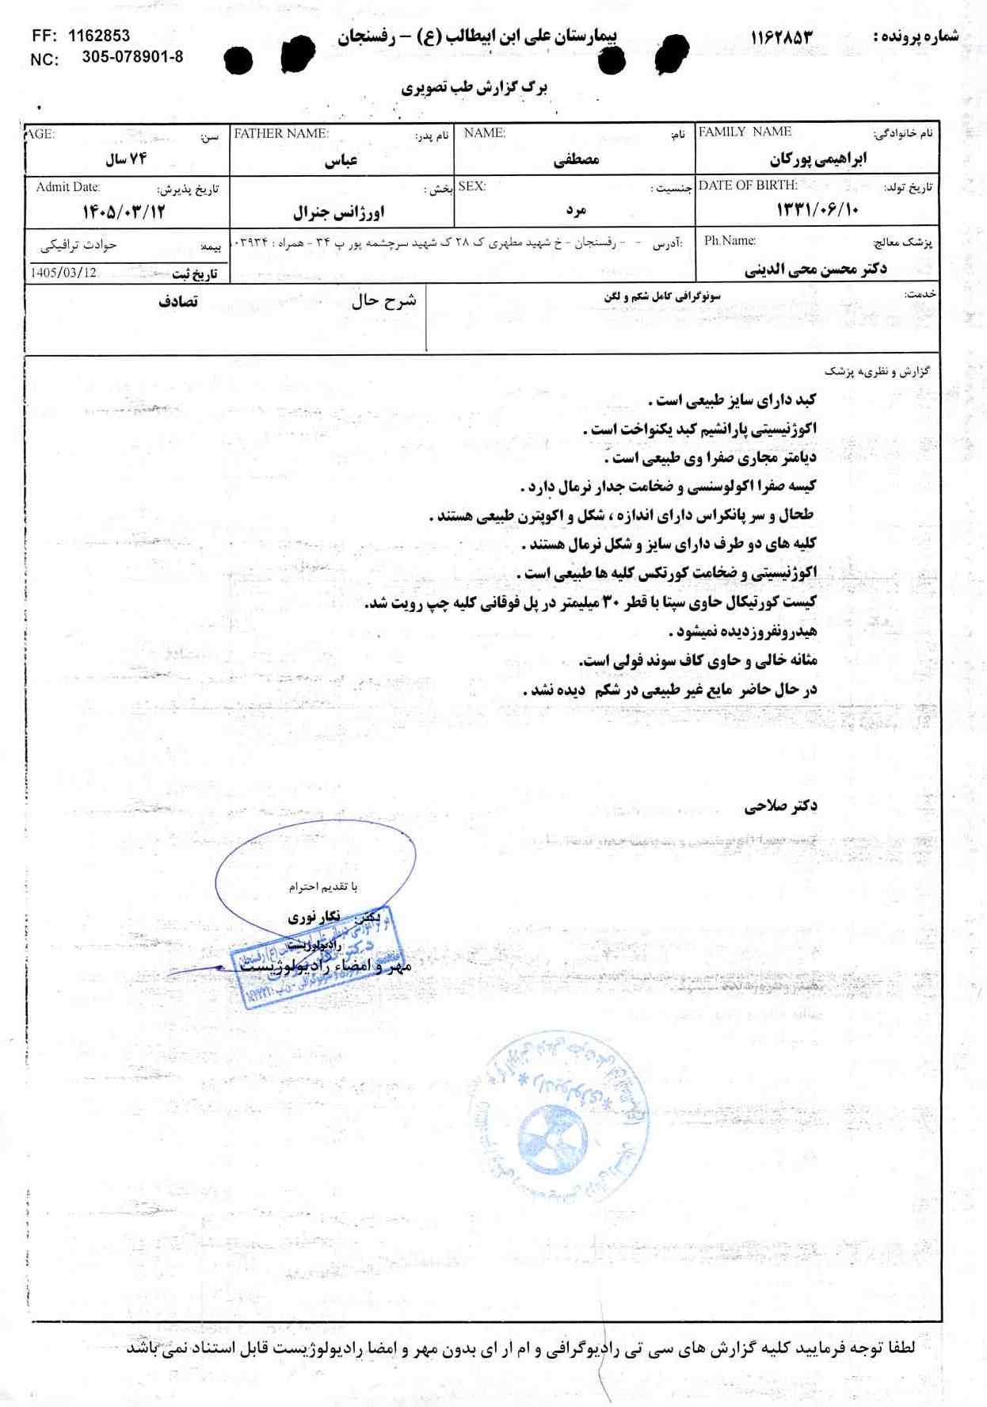
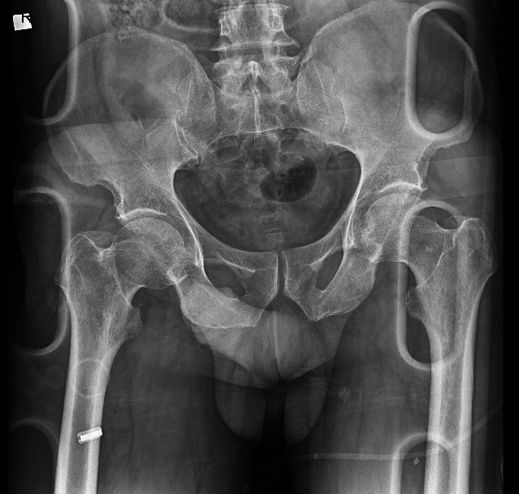
7:30
A Case Report Multiple Trauma
A 74 year old man was sent to this center by EMS following a pedestrian - car collision.
A
Secondary survey
B
Imaging
C
D
Pelvic xray
Abdomonopelvic Sonography
Thoracoabdominopelvic CT without contrast
E code: 1162853
17:30
E
19:30
F
G
H
23:00

Slide 22
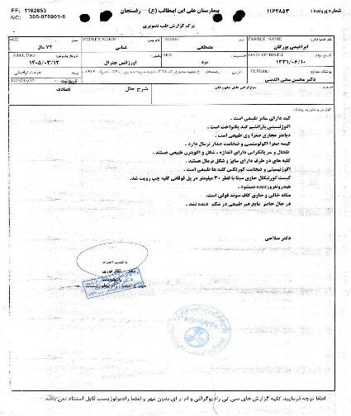
7:30
A Case Report Multiple Trauma
A 74 year old man was sent to this center by EMS following a pedestrian - car collision.
A
Secondary survey
Imaging
B
C
Pelvic xray
Abdomonopelvic Sonography
Thoracoabdominopelvic CT without contrast
E code: 1162853
D
17:30
E
19:30
F
G
H
23:00

Slide 23

7:30
A Case Report Multiple Trauma
A 74 year old man was sent to this center by EMS following a pedestrian - car collision.
A
Secondary survey
Imaging
B
C
Pelvic xray
Abdomonopelvic Sonography
Thoracoabdominopelvic CT without contrast
E code: 1162853
D
17:30
E
19:30
F
G
H
23:00

Slide 24
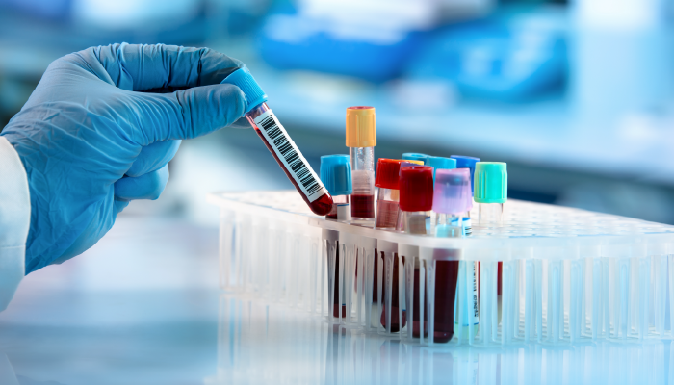
7:30
A Case Report Multiple Trauma
A 74 year old man was sent to this center by EMS following a pedestrian - car collision.
Secondary survey
A
Lab test
B
Time | WBC | Hb | Ht | Plt | Ptt | Pt | INR | Urea | Cr | Na | K | PH | BE | HCO3 | PCO2 | Trop
7:42 | 12400 | 15.5 | 47.5 | 300 | 36 | 13.4 | 1.05 | 48 | 1.23 | 135 | 4.0 | 7.290 | -9.7 | 15.9 | 34.2
9:03 | UA: Blood 3+ & WBC 4-6 & RBC many & Epithelial 10-15
10:56 |  |  |  |  |  |  |  |  |  |  |  |  |  |  |  | Neg
11:36 | 20900 | 14.1 | 42.5 | 218 |  |  |  |  |  |  |  | 7.223 | -6.6 | 21.6 | 54.3
11:51 |  |  |  |  |  |  |  |  |  |  |  |  |  |  |  | Neg
C
D
17:30
E
19:30
F
G
H
23:00

Slide 25
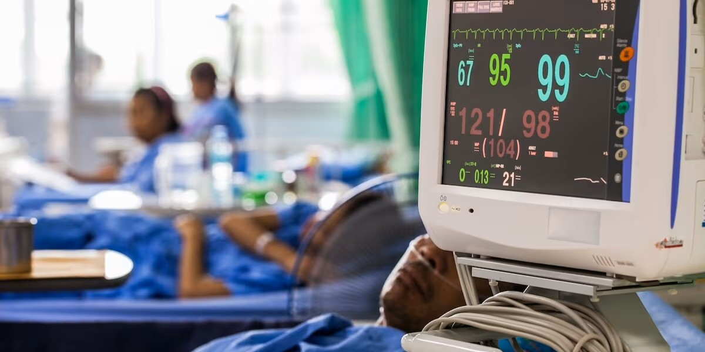
A Case Report Multiple Trauma
7:30
Being monitored and undergoing diagnostic and therapeutic procedures in the emergency room
A
B
C
ABCD Normal
Tolerated PO intake well
RBR
NO chest pain & NO other pain
NO desaturation
NO significant drop in HB
NO hypotention
NOT tachycardia
D
E
17:30
F
19:30
G
H
23:00

Slide 26
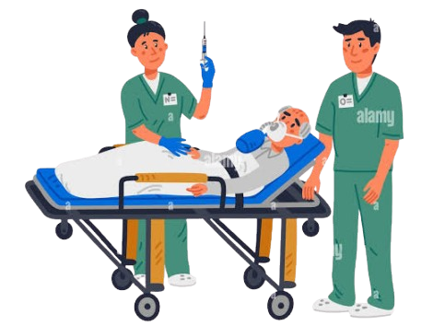
A Case Report Multiple Trauma
7:30
Being monitored and undergoing diagnostic and therapeutic procedures in the emergency room
ABCD Normal
Tolerated PO intake well
RBR
NO chest pain & NO other pain
NO desaturation
NO significant drop in HB
NO hypotention
NOT tachycardia
A
B
C
D
E
17:30
Transfer to the men's surgery department
F
19:30
G
H
23:00

Slide 27


A Case Report Multiple Trauma
7:30
Being monitored and undergoing diagnostic and therapeutic procedures in the emergency room
ABCD Normal
Tolerated PO intake well
RBR
NO chest pain & NO other pain
NO desaturation
NO significant drop in HB
NO hypotention
NOT tachycardia
A
B
C
D
E
17:30
Transfer to the men's surgery department
45 min
BP: 75
PR: 130
F
19:30
First CPR code
G
H
23:00

Slide 28
A Case Report Multiple Trauma
7:30
Being monitored and undergoing diagnostic and therapeutic procedures in the emergency room
ABCD Normal
Tolerated PO intake well
RBR
NO chest pain & NO other pain
NO desaturation
NO significant drop in HB
NO hypotention
NOT tachycardia
A
WBC | 12300 | PH | 6.625
HB | 9.1 | BE | -28.3
Ht | 33.2 | HCO3 | 8.6
Plt | 141 | PCO2 | 88.2
PTT | 90 | SGOT | 70
PT | 17.3 | SGPT | 179
INR | 1.44 | Alk | 175
ESR | 3 | Billi t | 0.6
CRP | 28 | Billi d | 0.2
Urea | 59 | D-dimer | 10.70
Cr | 2.71 | Trop | neg
Ca | 9.3
P | 15.3
Na | 142
K | 5
Alb | 3.0
B
C
D
Negative troponin
EKG
Negative FAST
Heart consultation
E
17:30
Transfer to the men's surgery department
F
45 min
BP: 75
PR: 130
19:30
First CPR code
G
Transfer to icu
H
23:00

Slide 29
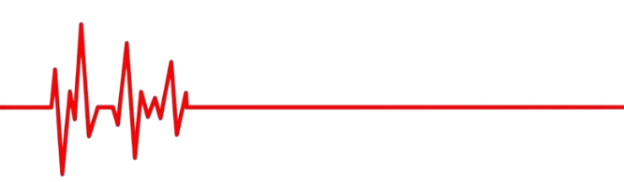
A Case Report Multiple Trauma
7:30
WBC | 12300 | PH | 6.625
HB | 9.1 | BE | -28.3
Ht | 33.2 | HCO3 | 8.6
Plt | 141 | PCO2 | 88.2
PTT | 90 | SGOT | 70
PT | 17.3 | SGPT | 179
INR | 1.44 | Alk | 175
ESR | 3 | Billi t | 0.6
CRP | 28 | Billi d | 0.2
Urea | 59 | D-dimer | 10.70
Cr | 2.71 | Trop | neg
Ca | 9.3
P | 15.3
Na | 142
K | 5
Alb | 3.0
Being monitored and undergoing diagnostic and therapeutic procedures in the emergency room
ABCD Normal
Tolerated PO intake well
RBR
NO chest pain & NO other pain
NO desaturation
NO significant drop in HB
NO hypotention
NOT tachycardia
A
B
C
D
E
17:30
Transfer to the men's surgery department
F
45 min
BP: 75
PR: 130
19:30
First CPR code
G
30 min
Transfer to icu
Negative troponin
EKG
Negative FAST
Heart consultation
H
Second CPR code
23:00

Slide 30

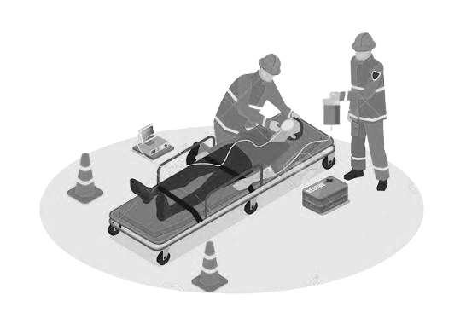
A Case Report Multiple Trauma
A
B
Expire
C
D
E
30 min
F
G
H
Second CPR code & expire
Attended by: Dr. Esmaeili
Presented by: Mahdi Poursalehi
Department of surgery
7:30
17:30
19:30
23:00

Slide 31
The End of
A Case Report Multiple Trauma
Attended by: Dr. Esmaeili
Presented by: Mahdi Poursalehi
Department of surgery

